Slide 1
Section 10.5
The Dot Product
Copyright © 2012 Pearson Education, Inc. Publishing as Prentice Hall.

Slide 2
Copyright © 2012 Pearson Education, Inc. Publishing as Prentice Hall.

Slide 3
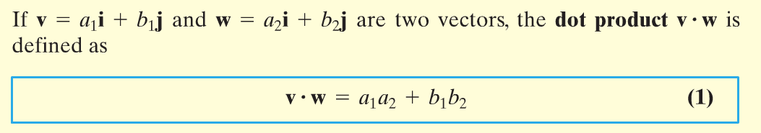
Copyright © 2012 Pearson Education, Inc. Publishing as Prentice Hall.

Slide 4


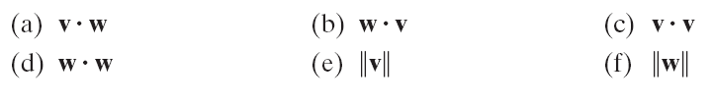
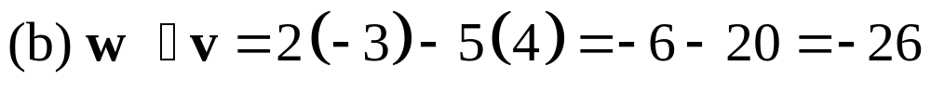
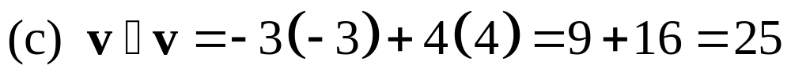
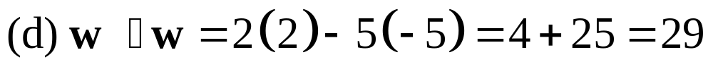
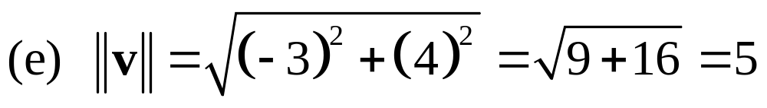
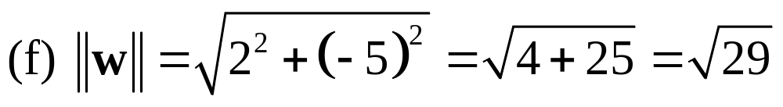
Copyright © 2012 Pearson Education, Inc. Publishing as Prentice Hall.

Slide 5
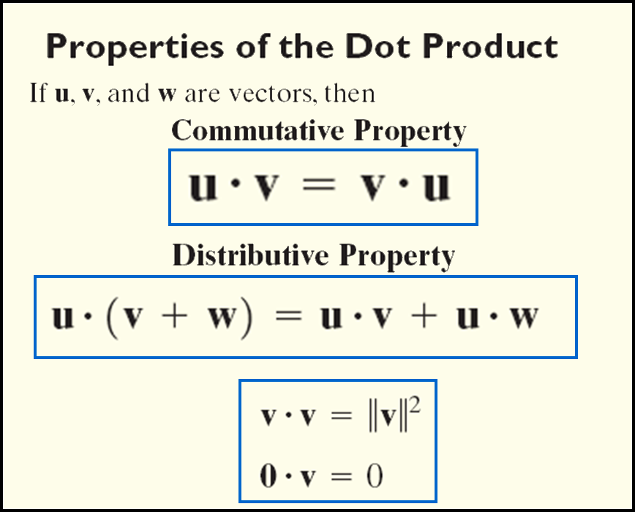
Copyright © 2012 Pearson Education, Inc. Publishing as Prentice Hall.

Slide 6
Copyright © 2012 Pearson Education, Inc. Publishing as Prentice Hall.

Slide 7

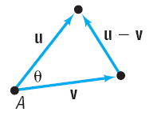

Copyright © 2012 Pearson Education, Inc. Publishing as Prentice Hall.

Slide 8

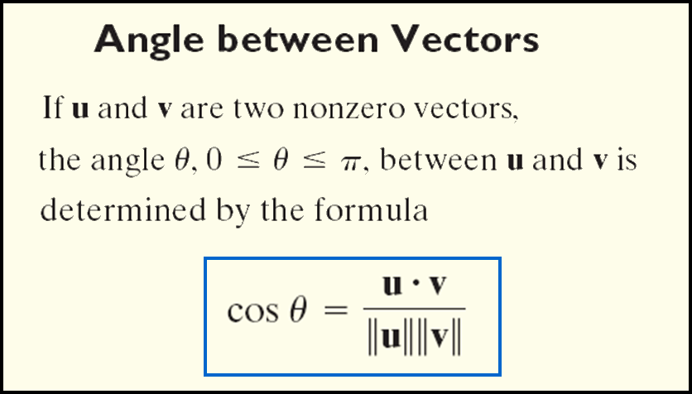
Copyright © 2012 Pearson Education, Inc. Publishing as Prentice Hall.

Slide 9



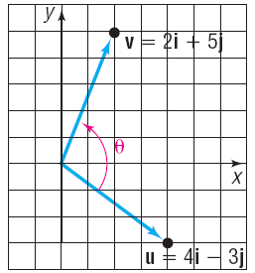



Copyright © 2012 Pearson Education, Inc. Publishing as Prentice Hall.

Slide 10
Copyright © 2012 Pearson Education, Inc. Publishing as Prentice Hall.

Slide 11
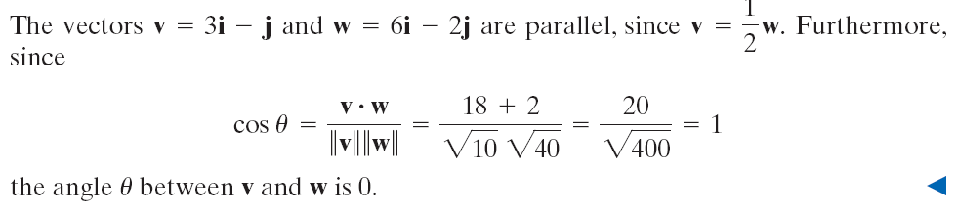
Copyright © 2012 Pearson Education, Inc. Publishing as Prentice Hall.

Slide 12
Copyright © 2012 Pearson Education, Inc. Publishing as Prentice Hall.

Slide 13
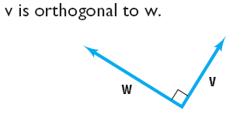

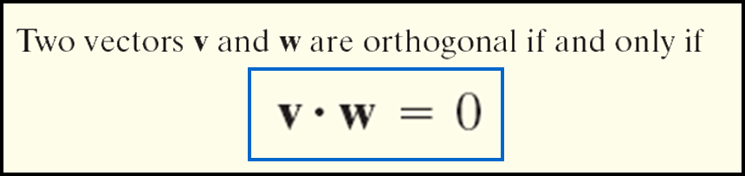
Copyright © 2012 Pearson Education, Inc. Publishing as Prentice Hall.

Slide 14
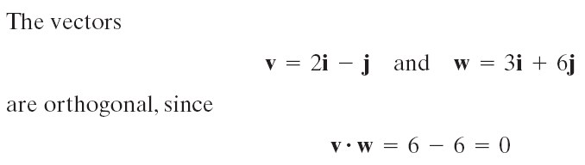
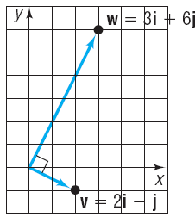
Copyright © 2012 Pearson Education, Inc. Publishing as Prentice Hall.

Slide 15
Copyright © 2012 Pearson Education, Inc. Publishing as Prentice Hall.

Slide 16
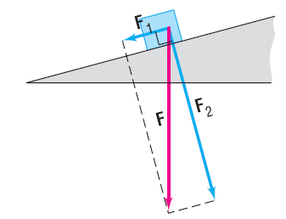
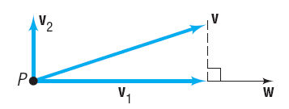
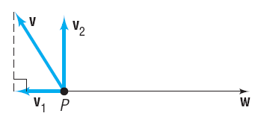
Copyright © 2012 Pearson Education, Inc. Publishing as Prentice Hall.

Slide 17

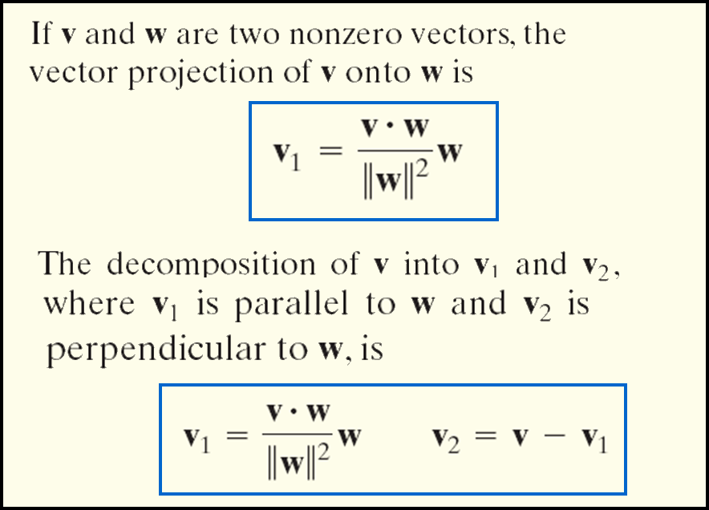
Copyright © 2012 Pearson Education, Inc. Publishing as Prentice Hall.

Slide 18
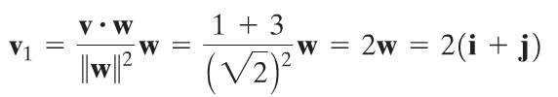
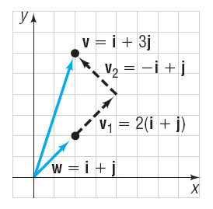
Copyright © 2012 Pearson Education, Inc. Publishing as Prentice Hall.

Slide 19




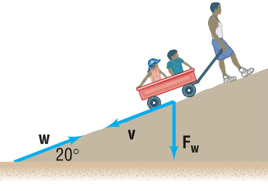

Copyright © 2012 Pearson Education, Inc. Publishing as Prentice Hall.

Slide 20

Copyright © 2012 Pearson Education, Inc. Publishing as Prentice Hall.

Slide 21
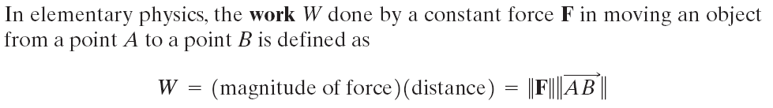
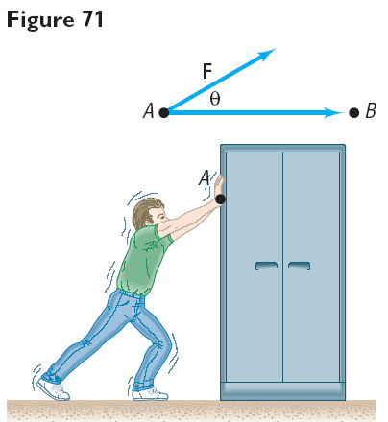

Copyright © 2012 Pearson Education, Inc. Publishing as Prentice Hall.

Slide 22

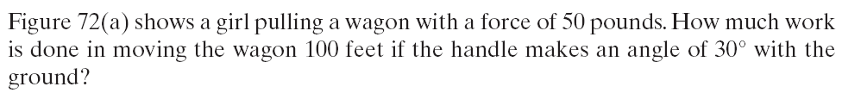
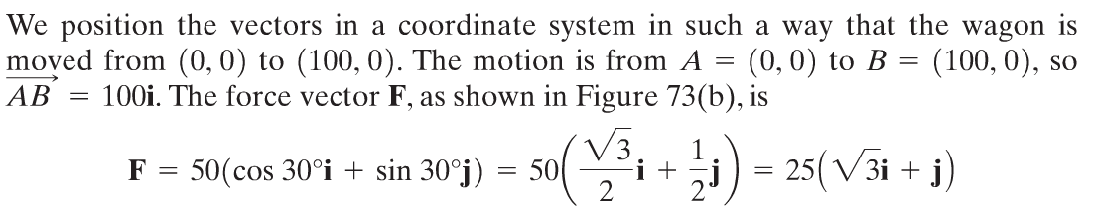
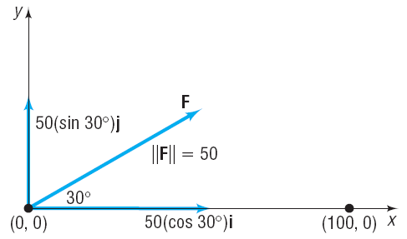
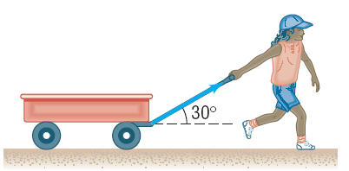
Copyright © 2012 Pearson Education, Inc. Publishing as Prentice Hall.

